Slide 1









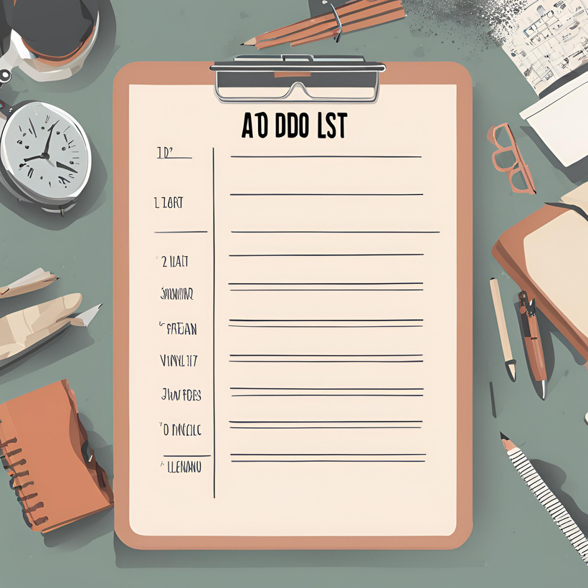





Personal TO-DO
Application
A Command-Line Based Task Management System
Presented by Shravya S

Slide 2
Difficulty keeping track of multiple tasks.
01.
Problem Statement
02.
Lack of categorization and prioritization.
Managing tasks and to-do lists can be overwhelming and disorganized.
03.
No centralized storage for tasks

Slide 3
Project Overview
01.
Create, view, edit, and delete tasks
A command-line based application to manage tasks and to-do lists.
Categorize tasks (Work, Personal, Urgent)
02.
Store tasks locally in a JSON file
03.

Slide 4
Features
01
02
03
04
Delete tasks,
Exit and save tasks
Add tasks with title, description, and category
View all tasks with status (completed/not completed)
Mark tasks as completed

Slide 5
Technical Requirements
- Python programming language
- JSON file for data storage
- Command-line interface

Slide 6
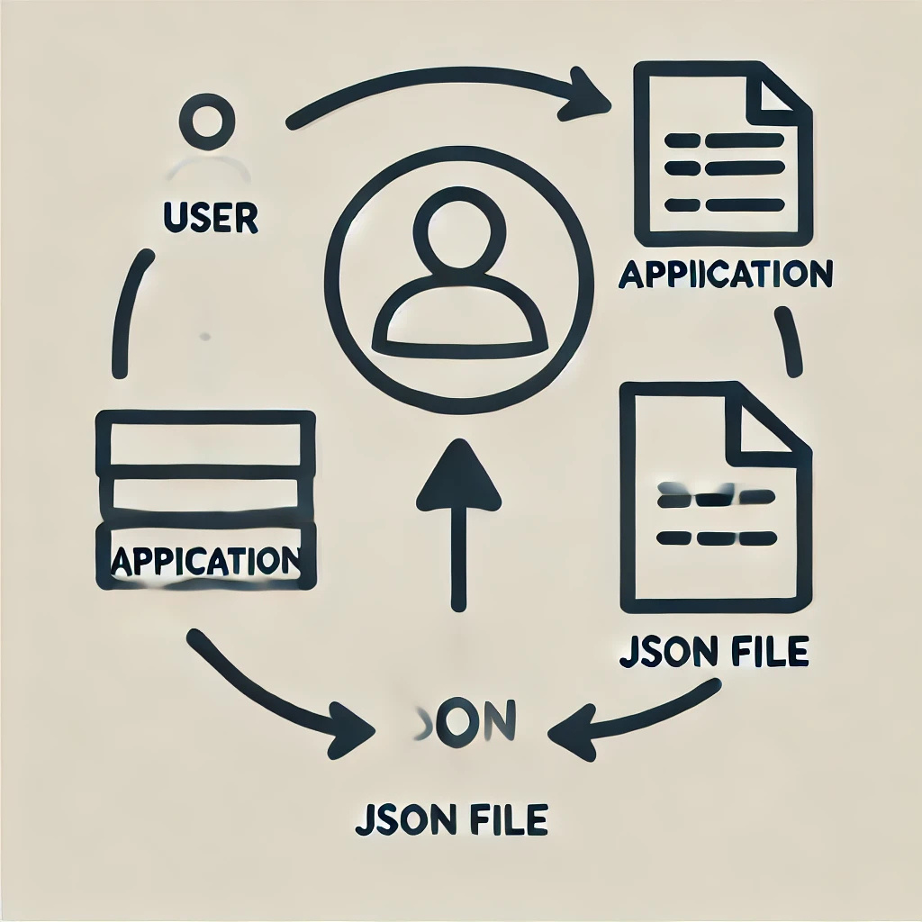
System Design

Slide 7
Task Class
class Task:
def __init__(self, title, description, category):
self.title = title
self.description = description
self.category = category
self.completed = False
def mark_completed(self):
self.completed = True
def __repr__(self):
return f"Task({self.title}, {self.description}, {self.category}, Completed: {self.completed})"

Slide 8






FILE HANDLING
Saving Tasks:
1. The save_tasks function is called when the user chooses to exit the application.
2. The function opens the tasks.json file in write mode ('w').
3. It uses the json.dump method to serialize the list of Task objects into a JSON string
4. The JSON string is written to the tasks.json file.
5. The file is closed.
def save_tasks(tasks):
with open('tasks.json', 'w') as f:
json.dump([task.dict for task in tasks], f, indent=4)
def load_tasks():
try:
with open('tasks.json', 'r') as f:
return [Task(**data) for data in json.load(f)]
except FileNotFoundError:
return []
Loading Tasks:
1. The load_tasks function is called when the application starts.
2. It attempts to open the tasks.json file in read mode ('r').
3. If the file exists, it uses the json.load method to deserialize the JSON string into a Python list.
4. The list contains dictionaries representing the Task objects.
5. The function creates new Task objects from the dictionaries using the Task(**data) syntax.
6. The list of Task objects is returned.

Slide 9
MAIN FUNCTION
def main():
tasks = load_tasks()
while True:
print("\n1. Add Task")
print("2. View Tasks")
print("3. Mark Task Completed")
print("4. Delete Task")
print("5. Exit")
choice = input("Choose an option: ")
# Option handling code...
if choice == '5':
save_tasks(tasks)
print("Tasks saved. Exiting...")
break
Command-Line Interface (CLI)
The CLI is a text-based interface where users interact with the application using commands.
User Interaction
1. The application displays a menu with options.
2. The user selects an option by entering the corresponding number.
3. Based on the user's choice, the application prompts for additional input (e.g., task title, description).
4. The user provides the required input.
5. The application performs the requested action (e.g., adds task, marks task completed).
CLI Menu Options
1. Add Task
2. View Tasks
3. Mark Task Completed
4. Delete Task
5. Exit

Slide 10
EXAMPLE USE CASES
- Adding a task:
- Enter task title: Buy groceries
- Enter task description: Buy milk and eggs
- Enter task category (Work/Personal/Urgent): Personal
- Marking a task completed:
- Enter task number to mark as completed: 1
CLI Output Examples
- Viewing tasks:
- 1. Buy groceries - Personal (Not Completed)
- 1. Finish project - Work (Completed)
- Successful task addition:
- Task added successfully!

Slide 11
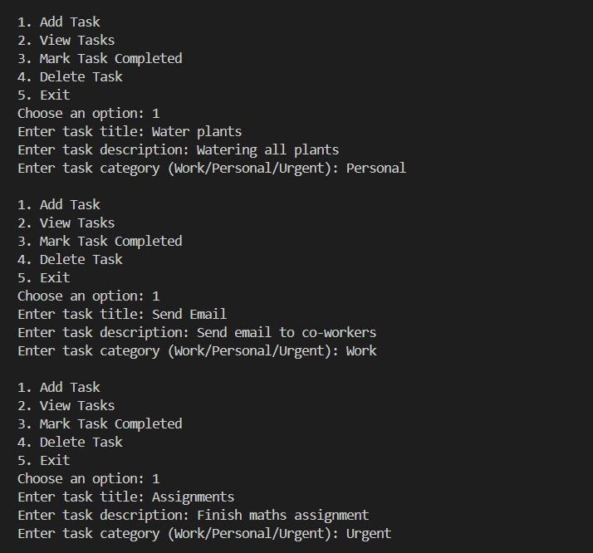
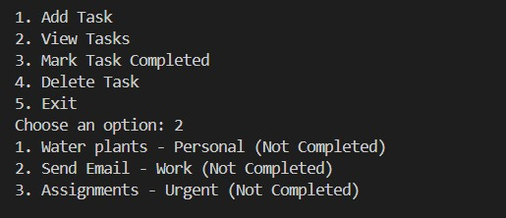
SNAPSHOTS

Slide 12
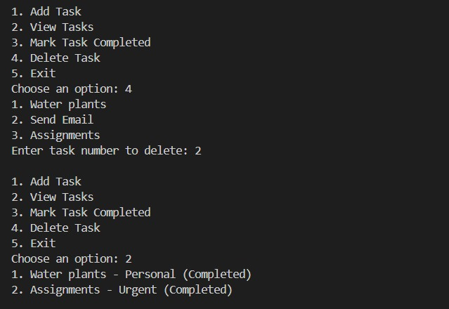
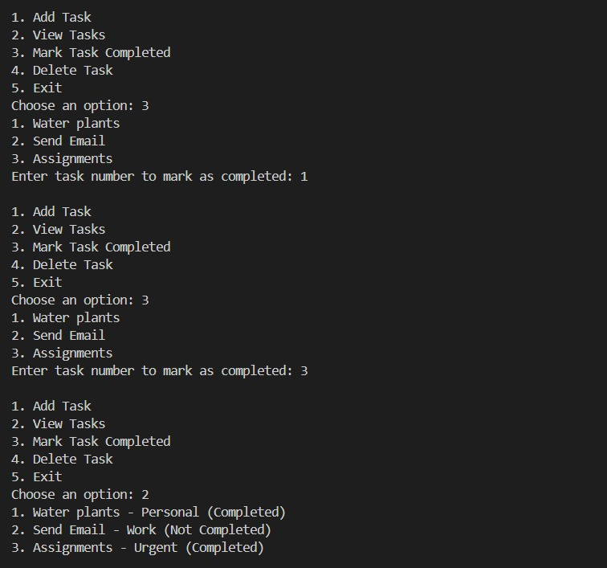

Slide 13
BENEFITS
- Easy to use and intuitive interface
- Effective task management and organization
- Local data storage for security and privacy

Slide 14
FUTURE ENHANCEMENTS
- Implement user authentication and authorization
- Add due dates and reminders
- Integrate with calendar or email services

Slide 15

CONCLUSION
The Personal To-Do List Application is a simple yet effective tool for managing tasks and to-do lists.

Slide 16
REFERENCES
www.google.com
ChatGpt
You tube
Git Hub

